Slide 1
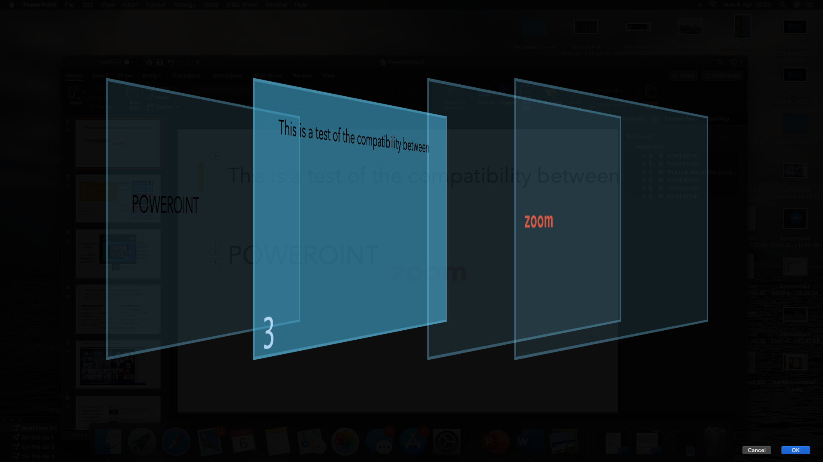
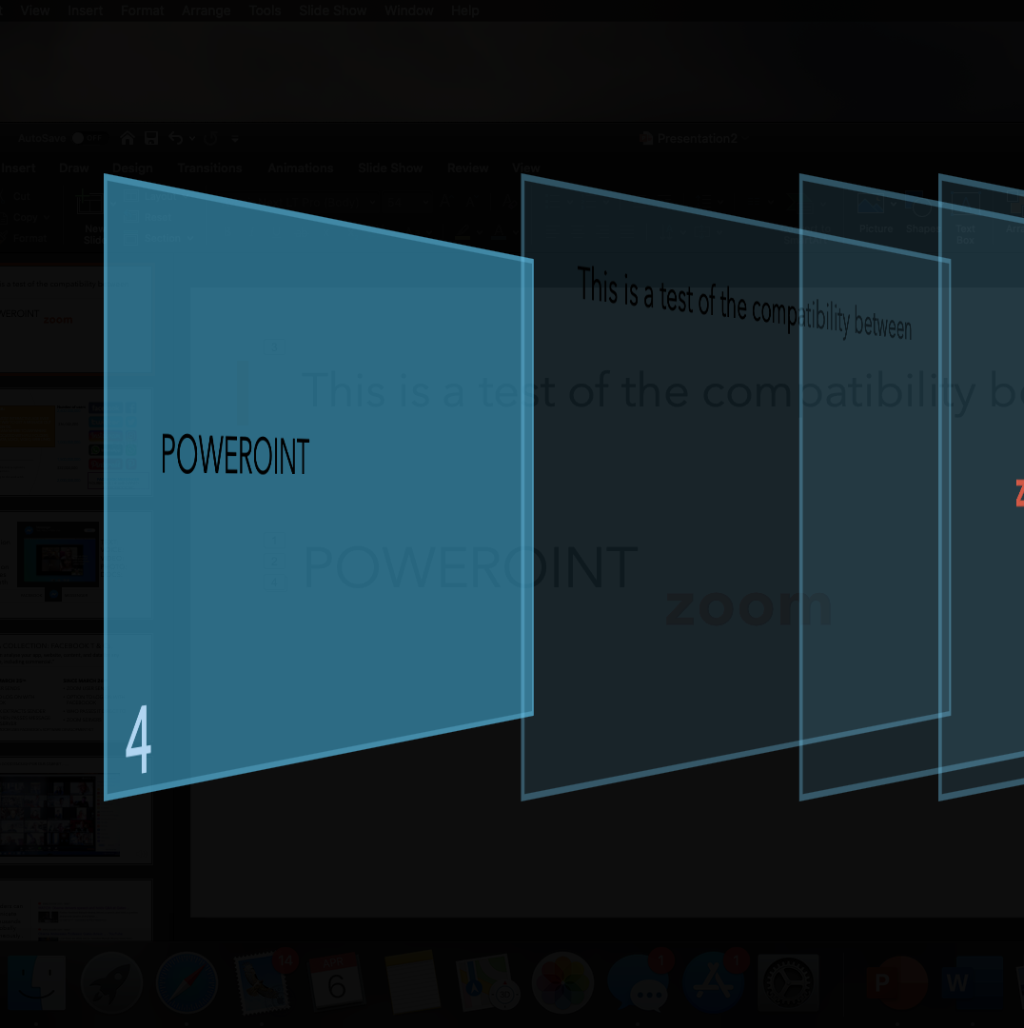
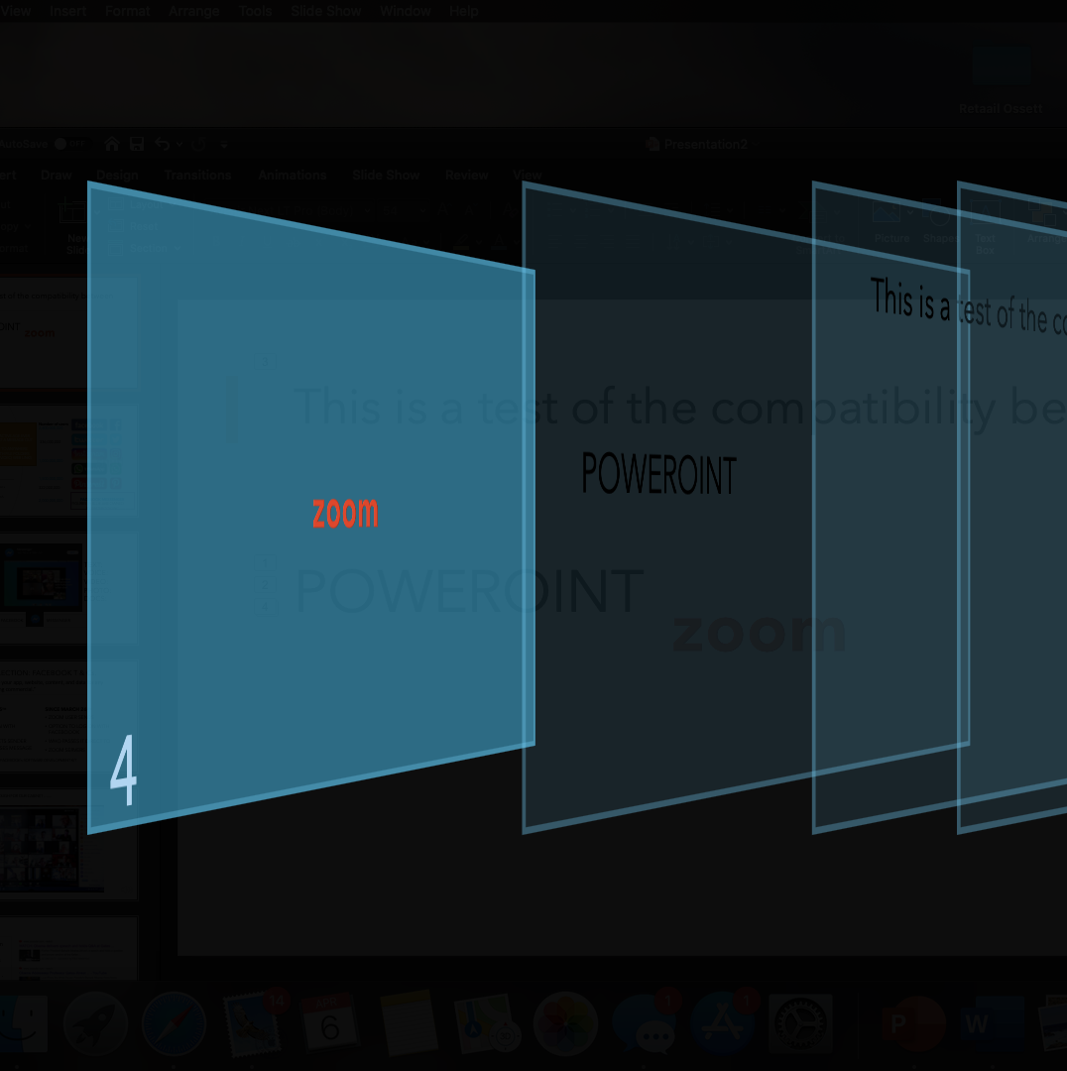
This is a test of the compatibility between POWER(P)OINT & zoom

Slide 2
This is a test of the compatibility between
On line, live, multi presentions………………………..
Keynote/powerpoint
Zoom &

Slide 3

SOCIAL MEDIA:
THIS IS THE MOST INTERACTIVE AGE EVER
THE FASTEST WAY TO GET A MESSAGE OUT FROM THE CENTRE
INPUT FROM ANYWHERE TO ANYWHERE
CAN BE ASSOCIATED WITH FILE FOLDERS SD CARDS DATA, VOICE, VIDEO, WEB LINKS
Number of users
2,600,000,000
336,000,000
1,000,000,000
1,500,000,000
322,000,000
2,000,000,000
A selection from the many options available dependant on
What you're trying to do and with whom
FACEBOOK MESSENGER
FIGURES IN BLUE ARE OWNED BY FACEBOOK INC.

Slide 4

Two billion TEXT: users VOICE:
VIDEO:
Two billion PHOTO: messages DOCS: per month
FACEBOOK MESSENGER

Slide 5
DATA COLLECTION: FACEBOOK T & Cs. “We can analyse your app, website, content, and data for any purpose, including commercial.”
BEFORE MARCH 25TH
SINCE MARCH 26TH
ZOOM USER SENDS
OPTION TO LOG ON WITH FACEBOOOK
FACEBOOK EXTRACTS SENDER DETAILS , THEN PASSES MESSAGE TO ZOOM SERVER
ZOOM USER SENDS
OPTION TO LOG ON WITH FACEBOOOK
WHO PASSES IT DIRECT TO
ZOOM SERVERS
ZOOM USES FACEBOOK’s SOFTWARE DEVELOPMENT KIT

Slide 6
STILL IF ITS GOOD ENOUGH FOR OUR CABINET ……

Slide 7
Our leaders can communicate with thousands of us globally simultaneously . can have website and/ aa You tube video channel
or a

Slide 8
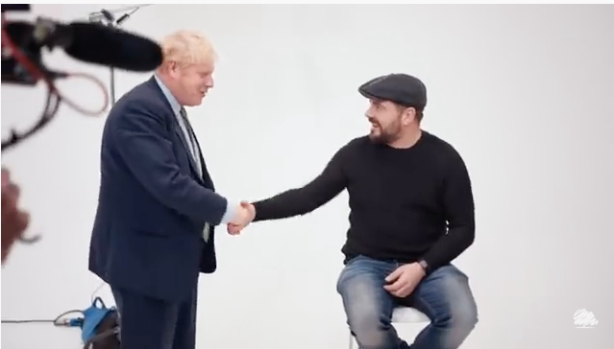
Or one to one
Prime Minister to a Labour voter who had voted Conservative for the 1st time
He had wanted to say thank you to the Prime Minster for listening to the electorate
Boris happened to be in the same building and obliged
They appeared to be pleased to meet each other

Slide 9
From anywhere to anywhere
Sick bed to:
Cabinet
TV Networks
Video link to any smart phone on the planet

Slide 10
NOW LETS SEE THE FACTS
ALL VERIFIED BY INDEPENDENT COMPANIES
YOU TUBE IS ACTUALY MULTI TUBULAR ~ STAGGERRINGLY SO ! 11 million inputs
AT ITS CORE
  500 MILLION HOURS OF FREE MATERIAL
  IF IT WAS RECORDED, SOUND , VISION OR BOTH IT’S PROBABLY ON YOU TUBE
  FROM THE EARLIEST FILM TO THE LATEST NEWS BROADCAST AND All BETWEEN

Slide 11
Anybody can join in
NO. of FOLLOWERS |  | COMMENTS
1 -100 | Hard work keeping it fresh | + 70% ON PREV.YEAR
100 – 1000 | Needs to be different to stand out from the average | STABLE
1000 – 1,000,000 | Now its FULL TIM with a lifee of it’s own | +65%
> 10,000,00 | Top echelon
 | >10,000,000 | NO.2 100M
 | > 10,000,00 | NO 1 122 M
But whose going to say enough’s , enough?

Slide 12
P
L
E
N
T
Y
of
H
E
L
P

Slide 13
1. BRING HISTORY ALIVE 1888
Traffic Crossing Leeds Bridge was filmed in Leeds, England in late October 1888, at 20 frames per second. For more information on the 1888 Crystal Palace recordings visit the following excellent YouTube page: Category
Science and Technology
SHORTCUT LINK

Slide 14
1888 RECORDED LIVE FROM ISRAEL & BROADCAST TO AN AUDIENCE IN THE CRYSTAL PALACE, LONDON
1888, the year of the death of the composer Charles-Valentin Alkan (Chopin's friend and neighbour) is also the year of the earliest surviving recording of music and earliest recorded film.
HERE live performance of Handel's oratorio Israel in Egypt conducted by Sir August Manns, recorded by Edison engineer George E. Gouraud at Crystal Palace, London, England, 29th June 1888)
CRYSTAL PALACE ,LONDON,ENGAND 29th June 1888

Slide 15
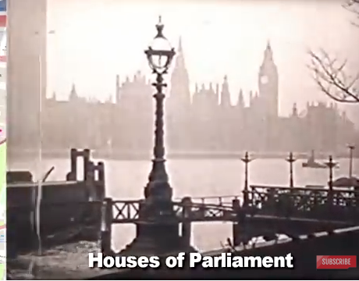
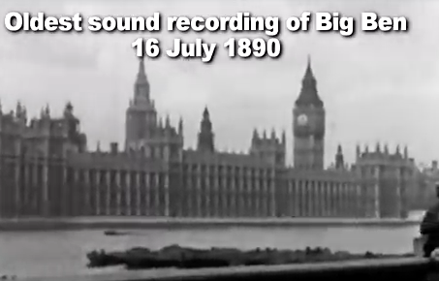
Earliest film of LONDON
1890
THE OLDEST RECORDING of BIG BEN
THE SOUND of BIG BEN
https://youtu.be/O_me3NrPMh8

